Slide 1
Note taking & Active listening

Slide 2

Hearing Vs Listening

Slide 3
Why can't people concentrate?
Pseudo-listening
Selective listening
Criticizing

Slide 4
Solutions
Awareness
Be physically and mentally prepared to listen
Set a goal
Sit in the front or center
Practice- dictation
Pretend to be fascinated if you have to

Slide 5
Active listening
Paying Attention
Demonstrating Listening Behaviors
Deferring Judgment
Responding Appropriately

Slide 6
Listening & Note Taking
An essential skill for university study.
Good note-taking allows a permanent record of key information that you can integrate with your own writing, and use for exam revision.
Reduces the risk of plagiarizing.
Helps you distinguish where your ideas came from and how and what you think about those ideas.

Slide 7
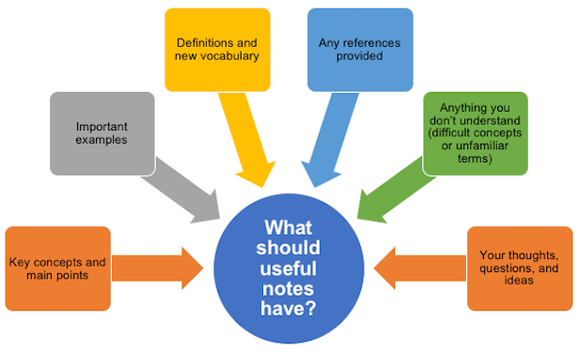

Slide 8

Six good reasons to take notes
Notes are a useful record of key information, and the sources of that information.
Writing notes helps you remember what you heard.
Taking notes helps you to concentrate and listen effectively.
Selecting what to note down increases your understanding.
Notes create a resource for exam preparation.
Notes taken in classes often contain information that can’t be found elsewhere.

Slide 9
Taking notes vs listening: which is more important?
Both are very important
Don’t focus on getting everything down to the extent that you miss what the lecturer is saying—remember that actively listening and thinking are what is important.
Lecture slides - an outline of the lecture content/ guide your listening and help you identify the key topics and concepts.
Take note of what appears on them, but don’t confine your note-taking to simply copying it.
The information is usually very limited compared to what the lecturer says, so it’s more effective to listen to the lecture and take notes from that.
Most lecturers make their slides available before class, so print them out and take additional notes in the lecture.

Slide 10
Before the Lecture: Be prepared
Know what the lecture will be about. Check the course outline for weekly topics.
Do any required pre-reading.
If lecture slides are available before class, download them.
Review notes from previous lectures.
Set up notebooks/ documents for note-taking.
Arrive on time and sit near the front - in order to take good notes, you need to hear and see clearly.

Slide 11
During the lecture: Strategies for effective note-taking
Concentrate and pay attention
Don’t try to write down everything being said

Slide 12
How can I recognize what is important?
Introductory remarks - Lectures often begin with a useful overview of the key ideas or themes of a topic. This helps you grasp the ‘big picture’.
Verbal ‘signposts’ - that indicate something important is about to be said. Lecturers often signal key information with phrases like: “There are four main aspects”, “This is important…” or “To sum up”.
Repetition - Important points will often be repeated, especially in introductions and conclusions.
Phonological cues - (voice emphasis, change in volume, speed, emotion and emphasis) often indicate important information.
Final remarks - Most lectures conclude with a summary, a restatement of the main ideas and an indication of how the topic connects with upcoming material.

Slide 13

Look for,
non-verbal cues (facial expressions, hand and body signals) that indicate something important is being said.
visual cues (note what is on the visuals, note references to names and sources)

Slide 14
After the Lecture
Read through your notes. Make sure they are clear and legible. Clean them up - fix spelling errors, expand on abbreviations, tidy up handwriting (if necessary).
Fill in missing words or information and add anything extra that you may have thought of since the lecture.
Code your notes - use colour and symbols to mark structure and emphasis, highlight major sections, main points and diagrams. Use different colours to emphasise main points, classify different topics and link concepts or information.
Explain and clarify diagrams by writing a simple version of their meaning.
Identify anything that needs further clarification.

Slide 15
Tips for re-engaging with notes
Try “chunking” similar pieces of information into categories that you can remember more easily.
write key concepts in your own words.
Add your own questions to the notes to help you recall the key ideas.
Write a brief overall summary of the notes.
Reflect on the learning process itself—what do you find confusing? How did you solve problems or clarify your understanding?

Slide 16
Techniques and Tips for Listening and Note Taking
Write phrases, not full sentences.
Take notes in your own words.
Structure your notes with headings, subheadings and numbered lists.
Code your notes
Use colour to highlight major sections, main points and diagrams.
Underline, circle, star, etc.
If you miss something, write key words, skip a few spaces, and get the information later.
Leave a space on the page for your own notes and comments.

Slide 17
Use concept maps and diagrams
Begin in the middle of the page and add ideas on branches that radiate from the central idea or from previous branches.
Arrows and words can be used to show links between parts of the concept map.
Colour and symbols are important parts of concept maps, helping illustrate ideas and triggering your own thoughts.

Slide 18
Use Symbols and Abbreviations
Common | etc. (etcetera) = and the rest e.g. = for example info = information i.e. = that is n.b. =note well, important p = page (pp = pages) | para = paragraph ch. = chapter no. = number diff = different C19 = nineteenth century

Slide 19
Personal | Develop your own set so that you don’t have to write every word in full. You can shorten any word that is commonly used in your lectures. Gov = government nec = necessary Work out a system you’ll remember and use it consistently. Introduce a few symbols and abbreviations at a time to help you remember them.

Slide 20
Acronyms | Some abbreviations are so well known and widely used that they have become acronyms—abbreviations pronounced as words. For example: Laser = Light Amplification by Stimulation Emission of Radiation ABC = Australian Broadcasting Corporation

Slide 21
Combine handwritten notes with electronic note-taking
If your lecturer provides lecture outlines, slides, or summaries of upcoming lectures, don’t just print them and skip note-taking in class—use these materials as frameworks to help structure your notes.
Save lecture slides as PDF files and annotate them. There are various applications that allow annotation of PDFs, such as Notability, iAnnotate, PDF Pen, Evernote or Adobe Acrobat Pro.
If notes or summaries are in Word, use the ‘track changes’ function to add annotations and comments.

Slide 22
Minimise distractions
If you use a laptop, make sure other programs are closed. Don’t try to ‘multitask’ whilst trying to note take—focus on one task and do it with maximum efficiency.
Consider getting a website or app blocker such as Self Control that can block distractions such as email or social media for a selected time period.

Slide 23
Typing vs writing notes: which is better?
‘pen and paper’ notes increases your focus and improves your comprehension and retention of lecture materials, more so than typing.
note-taking on a laptop or device can make notes easier to format, save, edit, share, and re-read (with no worries about messy handwriting).
Recording?
Transcribing?

Slide 24
Mind mapping – An engaging form of note taking
Think GRINDE!
G – Grouped
R – Reflective
I – Interconnected
N – Non-verbal
D – Directional
E – Emphasized

Slide 25
Sources
Listening note taking strategies(n.d), https://student.unsw.edu.au/note-taking-skills
https://www.youtube.com/watch?v=HEsBd_Rgzfs - Cornel Method

Slide 26
Challenge – Mind Mapping!
https://www.youtube.com/watch?v=qjBdcyueom8
Watch the video on ‘The Most Powerful Mindset for Success’ and take down notes!
Your challenge is to take down the notes in the form of a mind map!

